Slide 1












BANGLA PROGRAMMING LANGUAGE
A C LANGUAGE PROJECT
Project Done By-
Abdullah
ID: CE23011
Department of Computer Science and Engineering
Mawlana Bhashani Science and Technology University

Slide 2
SUPERVISOR
Dr.. Mostofa Kamal Nasir
Professor
Department of CSE, MBSTU.

Slide 3

Introduction:
This project aims to build a system where even the beginners can write code in their native language and see the output perfectly. With some more coding knowledge, they can customize the keywords to make it more comfortable!

Slide 4



How did I get the Idea?

Slide 5

Beginners’ Trouble
Programming is becoming increasingly popular and in demand, with even children learning to code today. However, in the initial stages, they often struggle to grasp fundamental programming concepts such as loops and conditionals.

Slide 6
Language Barrier
A significant barrier to this learning process is a lack of proficiency in English, as most programming languages closely resemble the English language.

Slide 7


Methodology

Slide 8

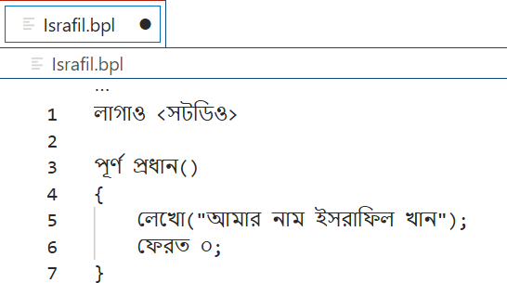



01
User writes a Bangla Programming language (.BPL) File.

Slide 9
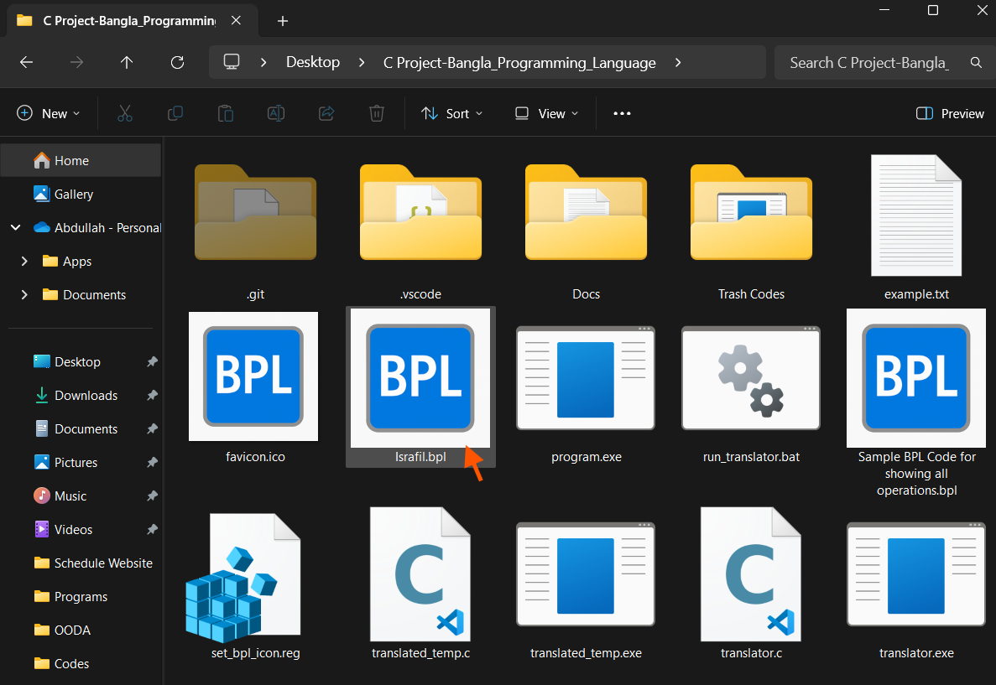
02
Saves the file and goes to the directory where it is saved.

Slide 10
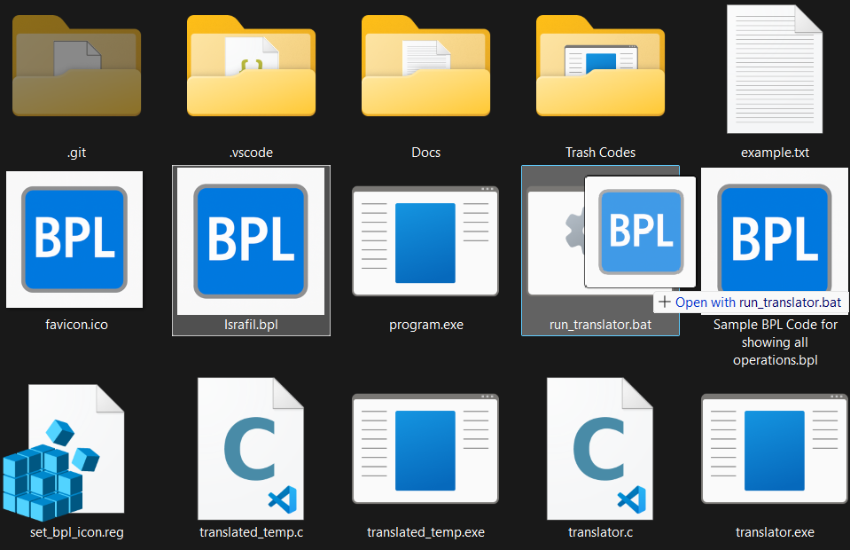
03
There is a .bat file to run the program. User drags and drops the .bat file or opens it with the .bat file.

Slide 11


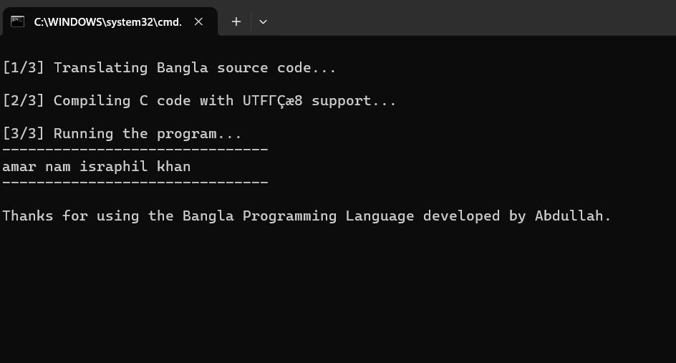




04
The output is shown in Command Line Interface (CLI) window.

Slide 12
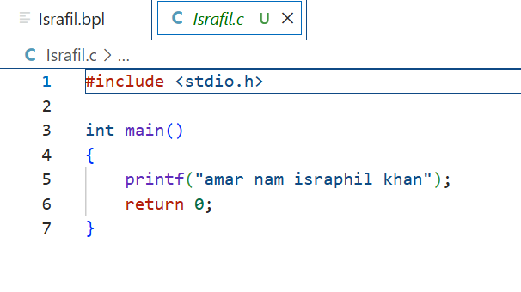
05
A file named bpl_file_name.c is created with equivalent C code.

Slide 13




What Is Happening Inside?

Slide 14

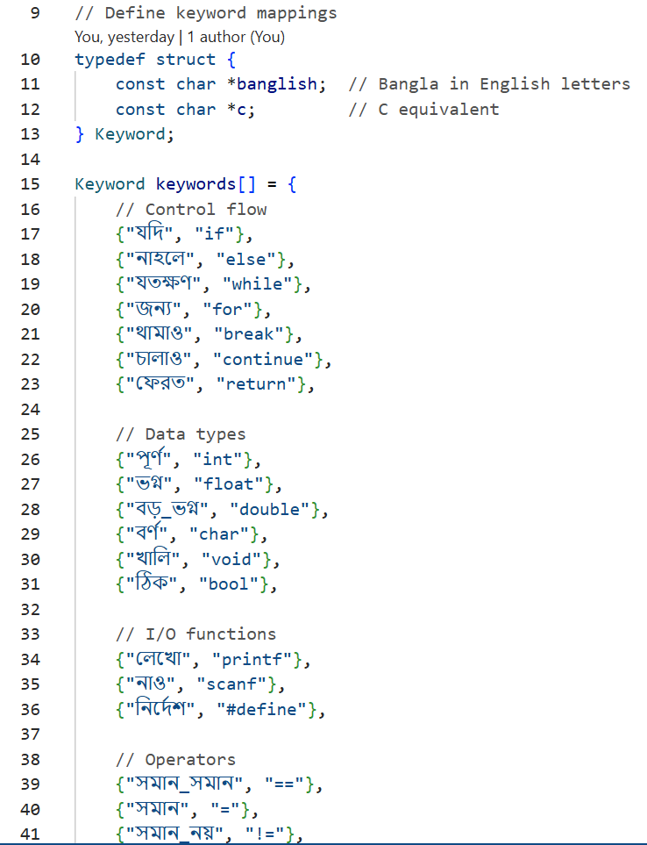
Firstly, We map the Keywords.

Slide 15
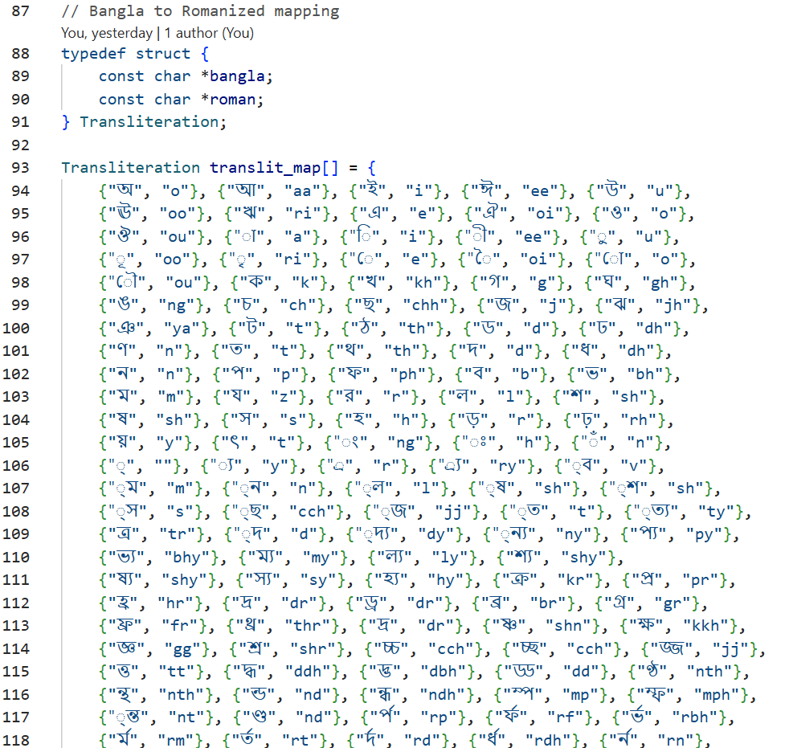
Then, We map the letters for Transliteration.

Slide 16
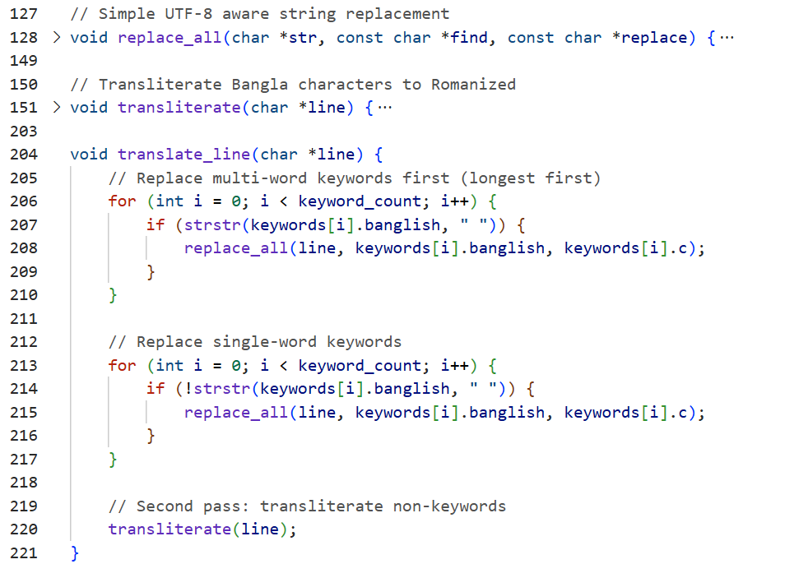
We Declare 3 functions

Slide 17
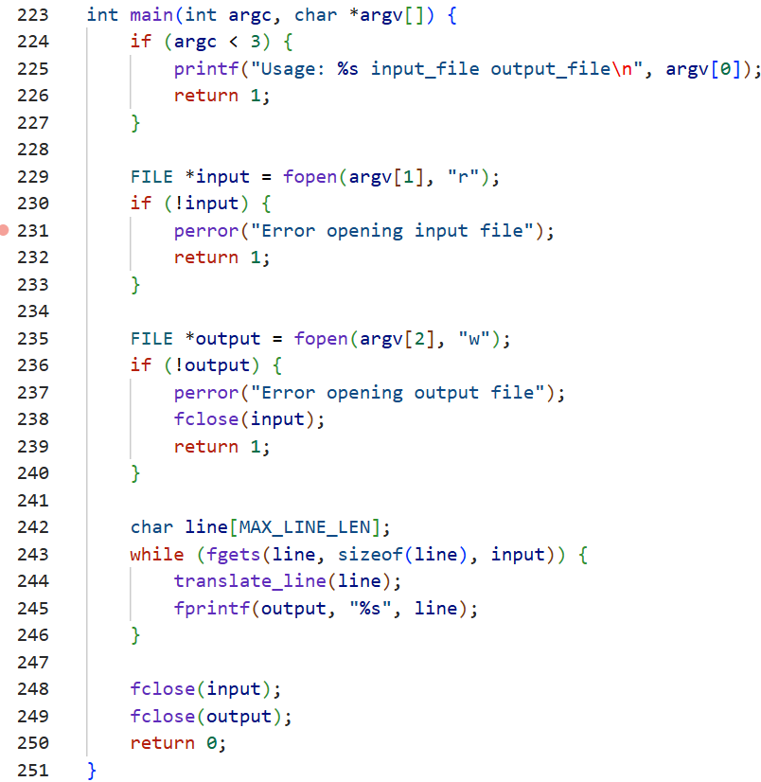
Finally, here is the main function

Slide 18



Features of C implemented in this project:
Header Files
Struct
User-defined functions
Built-in functions
File management

Slide 19
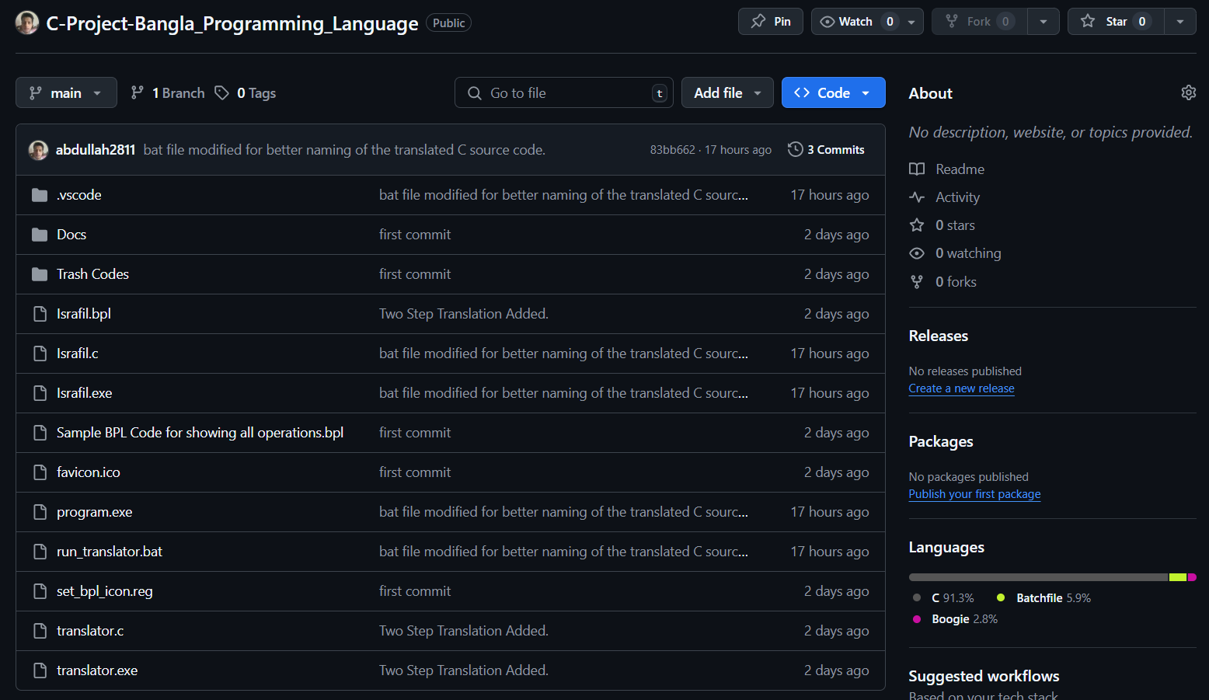
This Project on Github
1. Download translator.exe and run_translator.bat
2. Create a .bpl file
(e.g., hello.bpl)
3. Drag file onto run_translator.bat

Slide 20
Challenges I faced
Running the .bpl program
Running a file with unknown extension was a challenge. I made a .bat file that runs the translator program and works with the .bpl file.
Partial Keyword Collision
For example, replacing io with stdio.h broke words like option → optstdio.hon.
Solution: tokenized input properly using character-by-character parsing.
Terminal Compatibility
Bangla letters are not properly supported by terminal windows. They are corrupted and unreadable there. So those are replaced by roman letters.
Dynamic File Naming
Needed to prevent overwriting .c files with the same name.
Solved using auto-increment logic in the .bat script.
Transliteration Edge Cases
Some Bangla words looked similar but mapped differently.
Had to manually fine-tune the transliteration table for accuracy.

Slide 21
Future of this project
Support for Other Languages
Add support for Python, JavaScript, or Java.
Use the same Bangla keywords but output Python syntax.
Build a Visual Editor / IDE
A Bangla-based code editor with auto-suggestions, syntax highlighting, and real-time translation.
Could be a VS Code plugin or a standalone GUI app.
Add Error Detection & Debugging
Show errors in Bangla.
Help beginners understand what’s going wrong using plain language.
Semantic & Grammar Analysis
Build a parser using Lex/Yacc or ANTLR to detect logic errors, not just translate.
Mobile or Web Version
A web app or mobile app for students to write and test Bangla code without installing anything.

Slide 22





THANK YOU VERY MUCH

